Slide 1
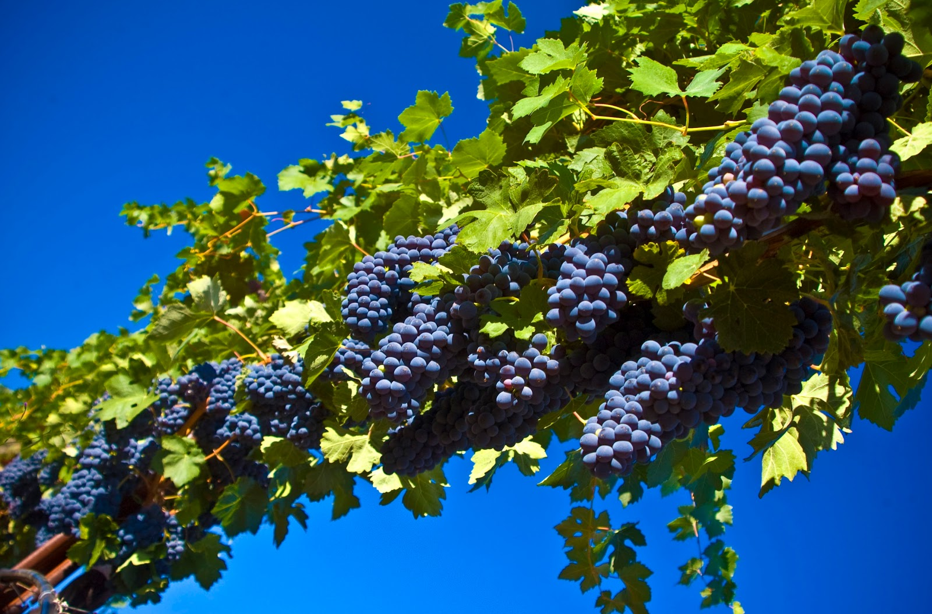
Grapes are the most grown fruit in the world A grapevine is Israel’s national emblem New plants are pruned for three to five years to train before they are allowed to produce a crop. Good roots produce for as many as 100 years
Grapevine facts:

Slide 2
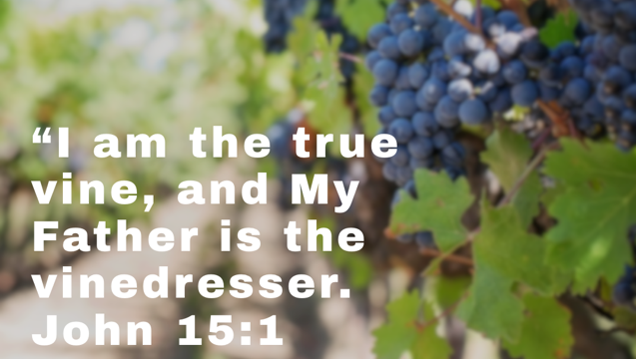

Slide 3
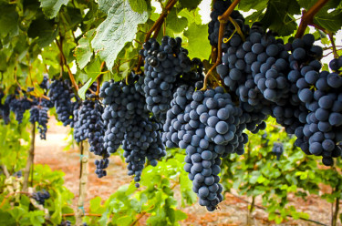
Full Vines – Fruitfulness

Slide 4
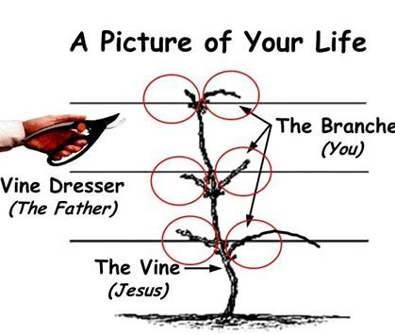
The Vine Dresser = Your Heavenly Father Vine = Jesus, Abide in Him
s
Fruit = Relationship with GOD
(Not what you do)

Slide 5
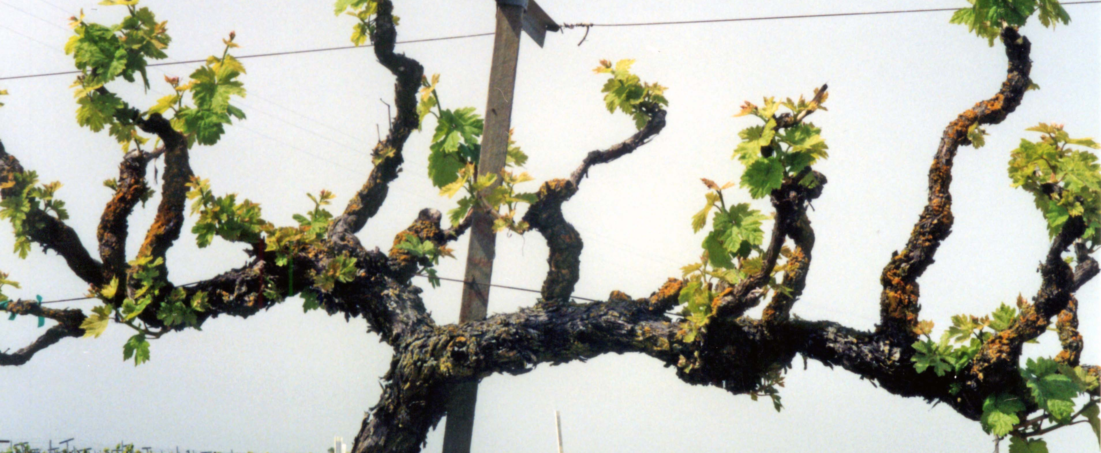
God rewards all growth with pruning.
Pruning in the kingdom is NOT punishment

Slide 6
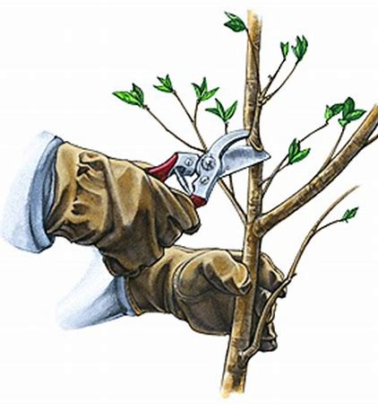
The Vine Dresser is closest to the branches when He is pruning them

